Slide 1




ScRNAseq Pipeline overview ScRNAseq in the Cloud
MDIBL Comparative Genomics and Data Science Core

Slide 2
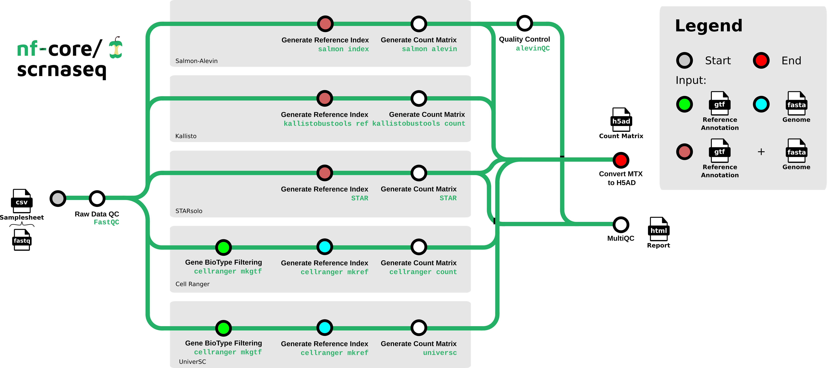
Metro Map
Notes:
Metro Map
Here, we have a diagram illistrating the different routes for analysis.
In this case, we have a relatively simplistic path in which each route is a different tool that eventually returns you with the same output.
In other cases, such as RNASEQ, this disgram can get a bit more complicated with various different end points, and lots of options:

Slide 3
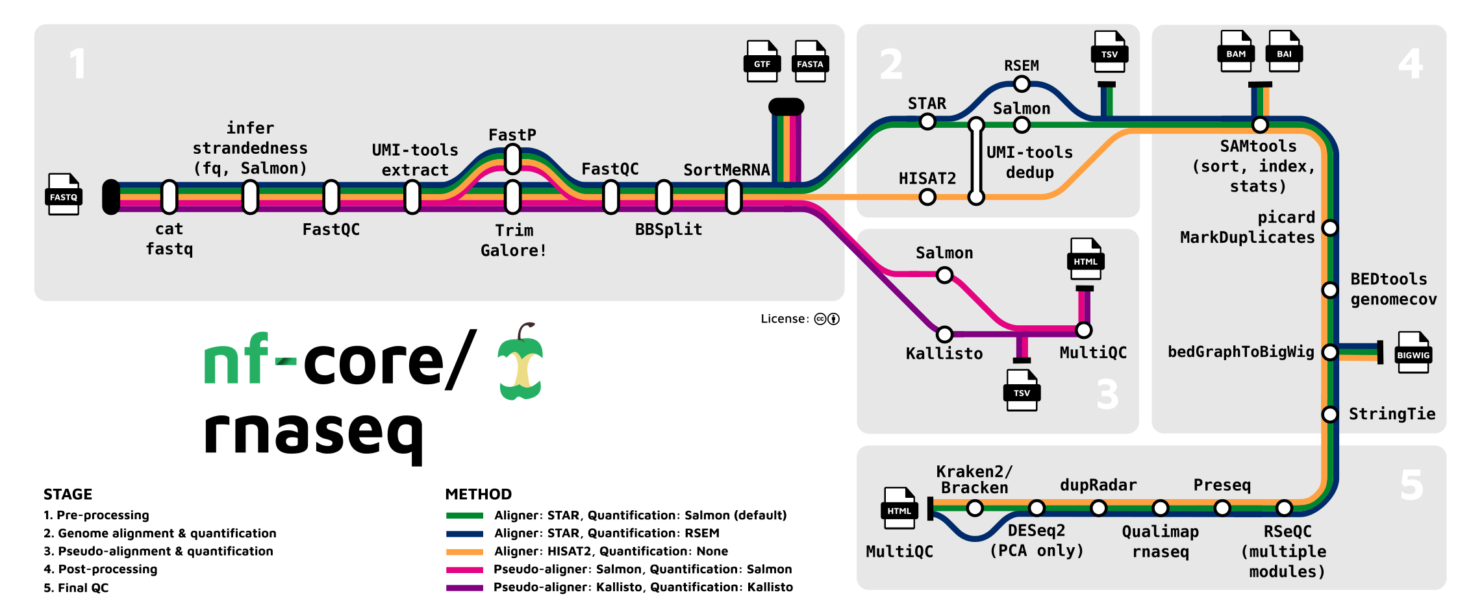
Metro Map (rnaseq)
Notes:
Metro Map
Here, we have a diagram illistrating the different routes for analysis.
In this case, we have a relatively simplistic path in which each route is a different tool that eventually returns you with the same output.
In other cases, such as RNASEQ, this disgram can get a bit more complicated with various different end points, and lots of options:

Slide 4
Metro Map
Notes:
Metro Map
Here, we have a diagram illistrating the different routes for analysis.
In this case, we have a relatively simplistic path in which each route is a different tool that eventually returns you with the same output.
In other cases, such as RNASEQ, this disgram can get a bit more complicated with various different end points, and lots of options:

Slide 5
Inputs
Notes:
Here is the main interface:
Modes: here we have a selector for the various different sections which we will cover in a few minutes.
Tools: The one on the left is for hiding the left hand side panel.
View: Here you can split the view that you have into various sections. For example, different strains, or different time points. WE will take a look at this in just a moment
Mouse: here you can decide how to use your mouse. We will play oround with the various options avalible here but generally it is for panning and selecting cells.
Export: pretty self explanatory, it is designed for exporting your plots and tables that can be produced within the browser.

Slide 6
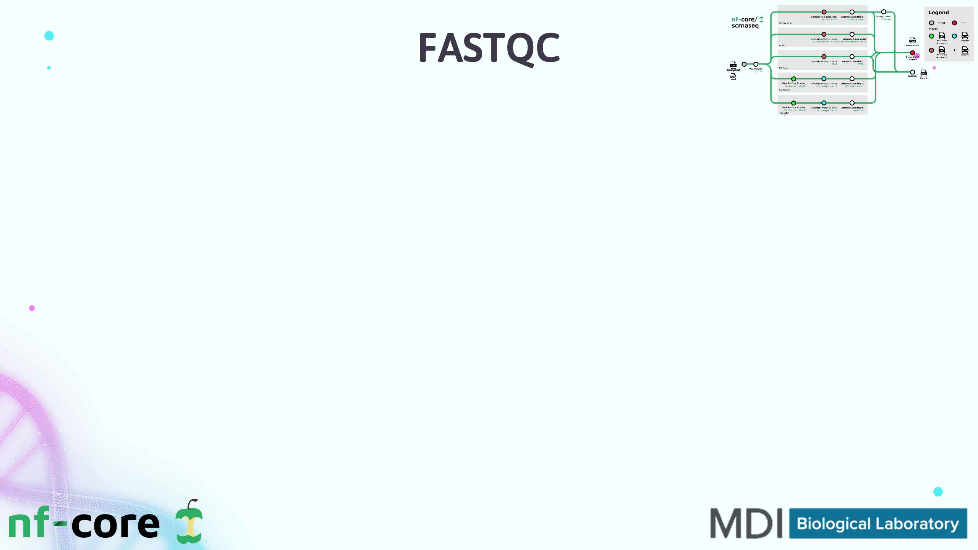


Inputs
Samples
References
Options
samplesheet.csv
sampleID,fastq_1,fastq_2
This defines the samples that will be processed
Each entry needs a Read 1 and Read 2
Samples need to be g-zipped.
<organism>.fasta.gz
Text-based file representing nucleotide (or protein) sequences. In our case organized by chromosome.
<organism>.gtf.gz
Gene Transfer Format file describes gene structure information specifically location of genes.
ALIGNER:
We will be choosing cellranger – specifically designed for 10x generated data.
Cellranger uses starSOLO as the alignment algorithm but make setup simple and easy.
Produces QC reports per sample.
Together, they will be used
to make our index.

Slide 7
Inputs
samplesheet.csv
sample,fastq_1,fastq_2
Young_Y1_kidney_29w,/staged-files-1/data/SRR9320581/Y1K1_R1_001.fastq.gz,/staged-files-1/data/SRR9320581/Y1K1_R2_001.fastq.gz
Young_Y1_kidney_29w,/staged-files-1/data/SRR9320582/Y1K2_R1_001.fastq.gz,/staged-files-1/data/SRR9320582/Y1K2_R2_001.fastq.gz
Young_Y1_spleen_29w,/staged-files-1/data/SRR9320585/Y1S1_R1_001.fastq.gz,/staged-files-1/data/SRR9320585/Y1S1_R2_001.fastq.gz
Young_Y3_kidney_31w,/staged-files-1/data/SRR9320586/Y3K1_R1_001.fastq.gz,/staged-files-1/data/SRR9320586/Y3K1_R2_001.fastq.gz
Young_Y3_kidney_31w,/staged-files-1/data/SRR9320587/Y3K2_R1_001.fastq.gz,/staged-files-1/data/SRR9320587/Y3K2_R2_001.fastq.gz
<organism>.gtf.gz
1 havana gene 108344807 108347562 . + . gene_id "ENSMUSG00000104478"; gene_version "2"; gene_name "Gm38212"; gene_source "havana"; gene_biotype "TEC";
1 havana transcript 108344807 108347562 . + . gene_id "ENSMUSG00000104478"; gene_version "2"; transcript_id "ENSMUST00000194081"; transcript_version "2"; gene_name "Gm38212"; gene_source "havana"; gene_biotype "TEC"; transcript_name "Gm38212-201"; transcript_source "havana"; transcript_biotype "TEC"; tag "basic"; tag "Ensembl_canonical"; transcript_support_level "NA (assigned to previous version 1)";
1 havana exon 108344807 108347562 . + . gene_id "ENSMUSG00000104478"; gene_version "2"; transcript_id "ENSMUST00000194081"; transcript_version "2"; exon_number "1"; gene_name "Gm38212"; gene_source "havana"; gene_biotype "TEC"; transcript_name "Gm38212-201"; transcript_source "havana"; transcript_biotype "TEC"; exon_id "ENSMUSE00001337335"; exon_version "2"; tag "basic"; tag "Ensembl_canonical"; transcript_support_level "NA (assigned to previous version 1)";
1 havana gene 6980784 6981446 . + . gene_id "ENSMUSG00000104385"; gene_version "2"; gene_name "Gm7449"; gene_source "havana"; gene_biotype "processed_pseudogene";
1 havana transcript 6980784 6981446 . + . gene_id "ENSMUSG00000104385"; gene_version "2"; transcript_id "ENSMUST00000194393"; transcript_version "2"; gene_name "Gm7449"; gene_source "havana"; gene_biotype "processed_pseudogene"; transcript_name "Gm7449-201"; transcript_source "havana"; transcript_biotype "processed_pseudogene"; tag "basic"; tag "Ensembl_canonical"; transcript_support_level "NA (assigned to previous version 1)";
<organism>.fasta.gz
>1 dna:chromosome chromosome:GRCm39:1:1:195154279:1 REF
ATCTCCATGCCATGGGAGAATAGAAATACATCTATCAGAGATATTGTCAGGACCCGAAAG
AAATGAAACCCAAAGTGGAGGTCCACTAGTGAGTATAATGATGGCAGGTATTTTTGCTGT
TACGCTGGGGCCTAGCAAACACATAAGTGGATGCTGGCTGTCAGCCATTGGATGGATCAC
AGGGCCCCCAATGGAGGAGCTAGAGAAAATACCCAAGGAGCTAAAGGGATCTGCAACCCT
TGTATCAAAAGATGGCCTAGCTGGCCATCACTGGATAGAGAGGCCCATTGGACTTGCAAA
TGCTCTGCCACTGAGCTGTGCCCTAGGTCTTAATATGAGTGCTGTGCTAGCATGGCTTGC

Slide 8
FASTQC
Notes:
Here is the main interface:
Modes: here we have a selector for the various different sections which we will cover in a few minutes.
Tools: The one on the left is for hiding the left hand side panel.
View: Here you can split the view that you have into various sections. For example, different strains, or different time points. WE will take a look at this in just a moment
Mouse: here you can decide how to use your mouse. We will play oround with the various options avalible here but generally it is for panning and selecting cells.
Export: pretty self explanatory, it is designed for exporting your plots and tables that can be produced within the browser.

Slide 9
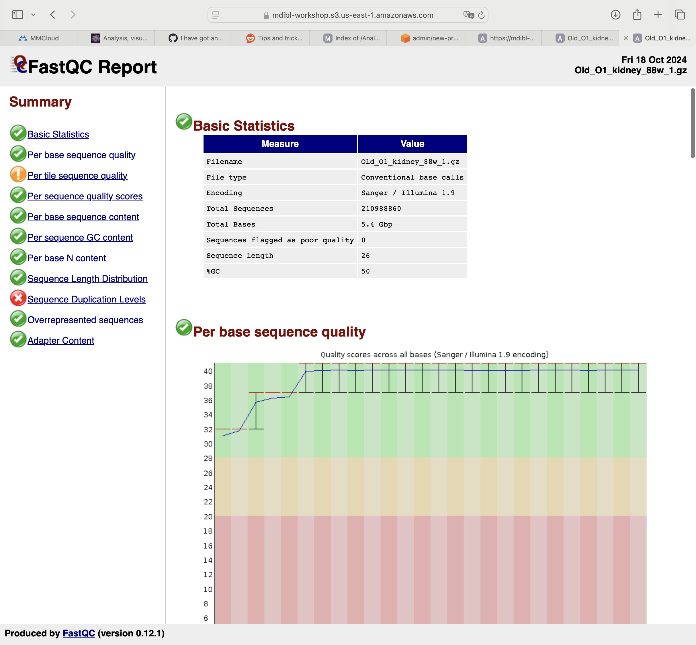

FASTQC
What
Output
Readouts
Tool for assessing the quality of raw sequencing.
Commonly used for high-throughput sequencing such as ScRNAseq.
HTML file
Each sample has 2 files:
Read 1
Read 2
Basic Statistics
Per base sequence quality
Per sequence quality score
Per base sequence content
Per sequence GC content
Per base N content
Sequence Length Distribution
Sequence Duplication Levels
Overrepresented sequences
Adapter Content
The .fastq files do not get modified in any way during this step.
FASTQC only interprets the .fastq files.

Slide 10
cellranger mkgtf
Notes:
Here is the main interface:
Modes: here we have a selector for the various different sections which we will cover in a few minutes.
Tools: The one on the left is for hiding the left hand side panel.
View: Here you can split the view that you have into various sections. For example, different strains, or different time points. WE will take a look at this in just a moment
Mouse: here you can decide how to use your mouse. We will play oround with the various options avalible here but generally it is for panning and selecting cells.
Export: pretty self explanatory, it is designed for exporting your plots and tables that can be produced within the browser.

Slide 11
cellranger mkgtf
What
Why
Output
Pre-processing step run by cellranger to prepare the .gtf file.
.gtf files do not always conform to a strict organization.
Often, there is additional information in the .gtf file that is not needed for cellranger.
A slimmed down .gtf that is properly formatted to ensure that the subsequent cellranger processes are run correctly and efficiently.

Slide 12
cellranger mkref
Notes:
Here is the main interface:
Modes: here we have a selector for the various different sections which we will cover in a few minutes.
Tools: The one on the left is for hiding the left hand side panel.
View: Here you can split the view that you have into various sections. For example, different strains, or different time points. WE will take a look at this in just a moment
Mouse: here you can decide how to use your mouse. We will play oround with the various options avalible here but generally it is for panning and selecting cells.
Export: pretty self explanatory, it is designed for exporting your plots and tables that can be produced within the browser.

Slide 13
cellranger mkref
What
Why
Output
Builds an index or map to be used for aligning your reads.
Takes in both the .fasta (sequence data) and .gtf (gene annotations).
Having an index ensures the alignment step runs efficiently and accurately.
A structured directory containing the index and auxiliary files to be used in the cellranger count step.

Slide 14
cellranger count
Notes:
Here is the main interface:
Modes: here we have a selector for the various different sections which we will cover in a few minutes.
Tools: The one on the left is for hiding the left hand side panel.
View: Here you can split the view that you have into various sections. For example, different strains, or different time points. WE will take a look at this in just a moment
Mouse: here you can decide how to use your mouse. We will play oround with the various options avalible here but generally it is for panning and selecting cells.
Export: pretty self explanatory, it is designed for exporting your plots and tables that can be produced within the browser.

Slide 15
cellranger count
What
How
Output
This is the most computationally intensive task in the pipeline.
Takes the reads (from the .fasta files) and uses the index created in cellranger mkref to map what gene each read matches.
Two pass solution:
Pass one: reads are aligned to the reference genome. Spice junction (both known and novel) and logged.
Junctions are then filtered based on number of reads supporting the junction.
Pass two: reads are once again aligned, but with this filtered set of junctions from the first pass.
Key Output: raw and filtered counts
Structured in a directory that contains 3 files (MEX format):
features.tsv.gz
barcodes.tsv.gz
matrix.mtx.gz
Notes:
STAR: Spliced Transcripts Alignment to a Reference
Discuss raw vs filtered
Discuss MEX format later on in the stats class.

Slide 16
post-alignment
Notes:
Here is the main interface:
Modes: here we have a selector for the various different sections which we will cover in a few minutes.
Tools: The one on the left is for hiding the left hand side panel.
View: Here you can split the view that you have into various sections. For example, different strains, or different time points. WE will take a look at this in just a moment
Mouse: here you can decide how to use your mouse. We will play oround with the various options avalible here but generally it is for panning and selecting cells.
Export: pretty self explanatory, it is designed for exporting your plots and tables that can be produced within the browser.

Slide 17
post-alignment
Extra Outputs
pipeline_info
multiqc
This pipeline produces extra outputs mostly consisting of additional file conversions.
MEX → H5ad
MEX → rds
Overview of the execution of the pipeline.
Report
Timeline
Dag
A full breakdown of the workflow reporting results and statistics on the steps run.
Notes:
Dag stands for Directed Acyclic Graph. (non-cyclic) Illustrate workflow.

Slide 18
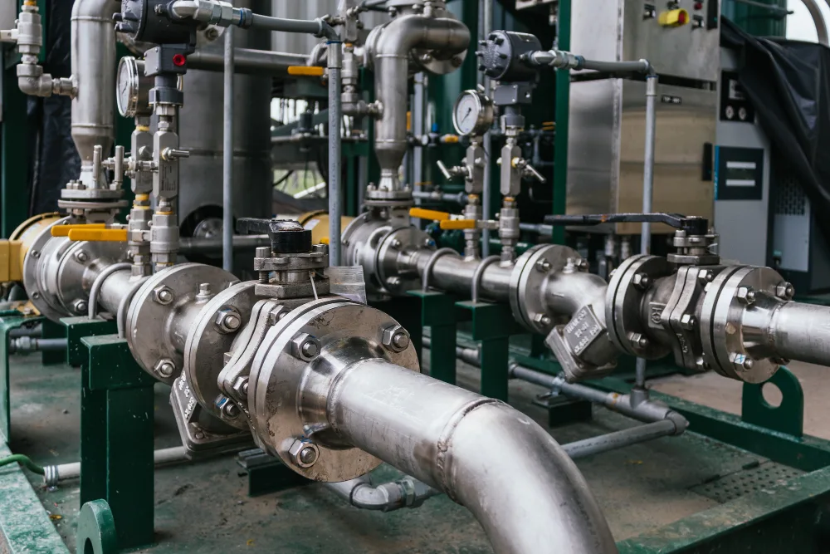

Questions?

